Slide 1
License Plate Recognition
By Guangxing Ren，XiYou and Jiafei
Boston University 12/07/2018

Slide 2
Motion
Nowadays, millions of monitors scatter around every corner of city. Through the cameras, it can help us to identify each car by license plate recognition.

Slide 3
Overall process
1. Load in the sample images used for K nearest computation, in our case K = 1. 2. Plate Detecting, we need to locate the region of the plate we are going to recognize. 3. At last we try to get the content of the plate.

Slide 4
K-NN process
For the first step, for k-nearest neighbors algorithm, we train the data for classification and image. We input a template that contain all the numbers and letter that lisence plate possibly contain.

Slide 5
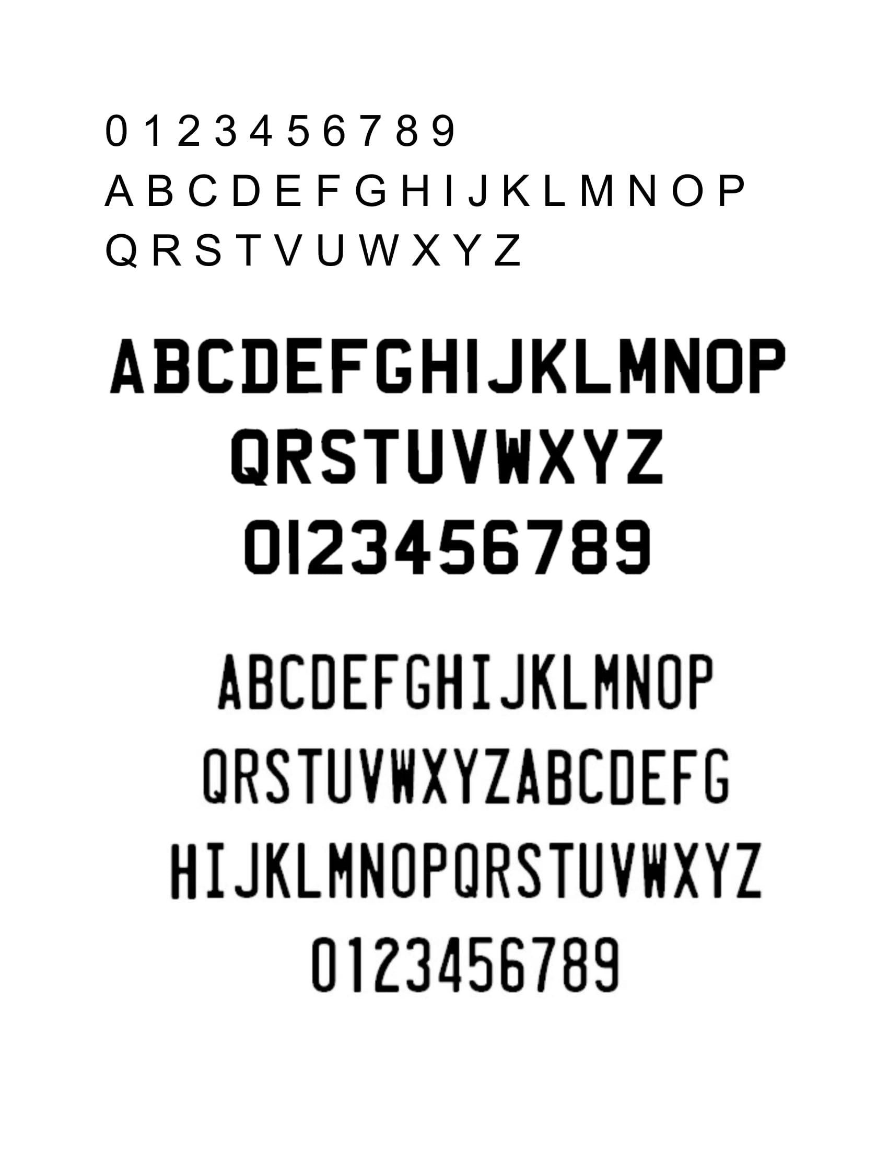
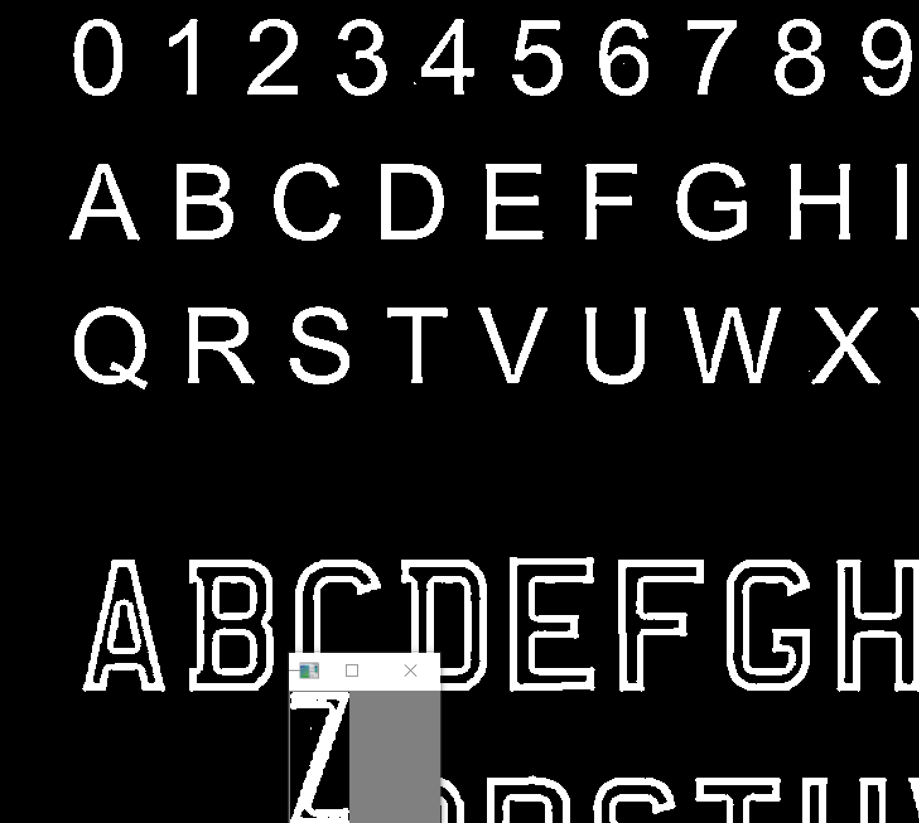
Preprocess(for KNN training)
Template Training Process
For this case, we should manual
type “Z”

Slide 6
Plate localization
Preprocess
Character contour detection
Plate extraction

Slide 7
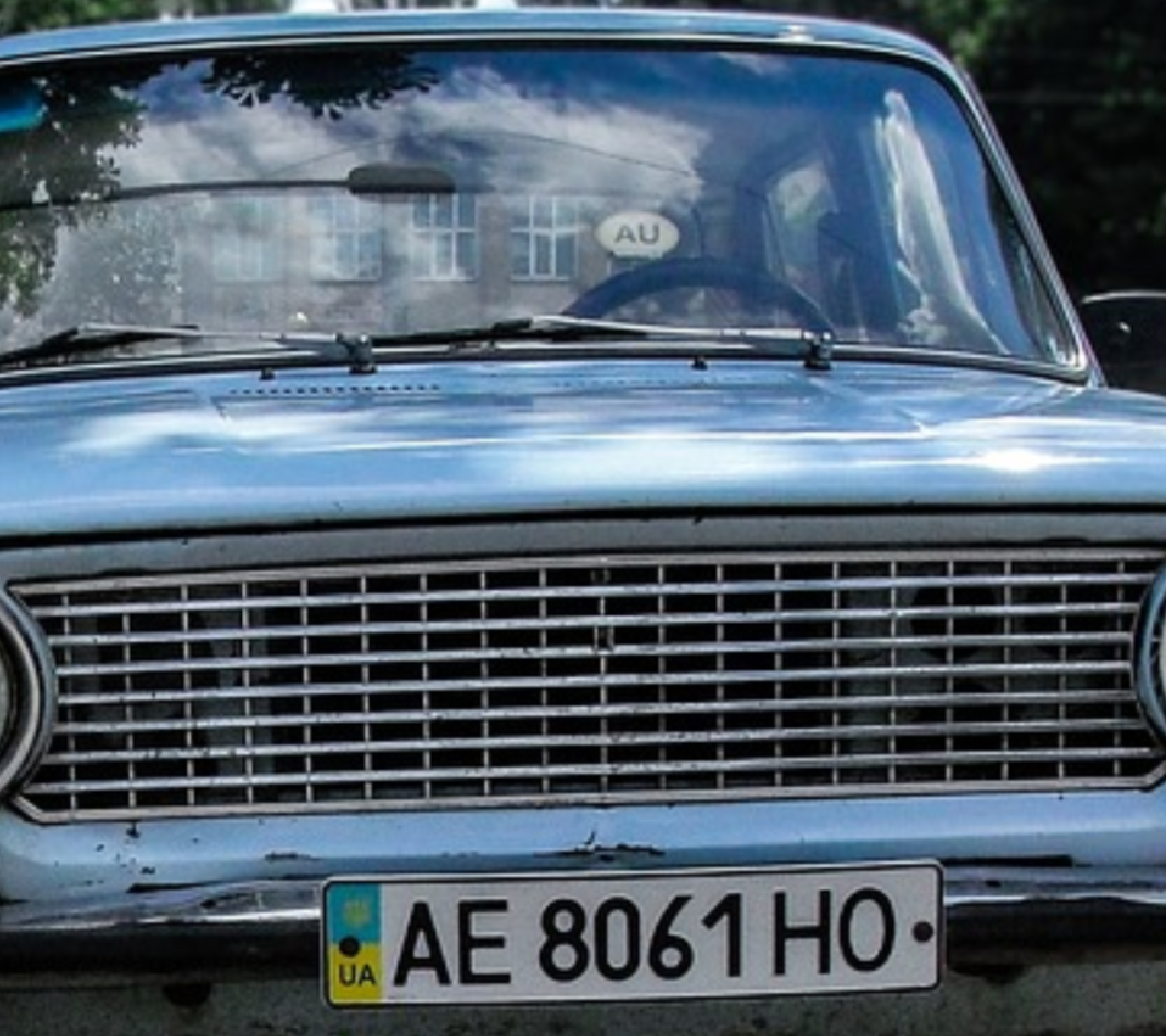
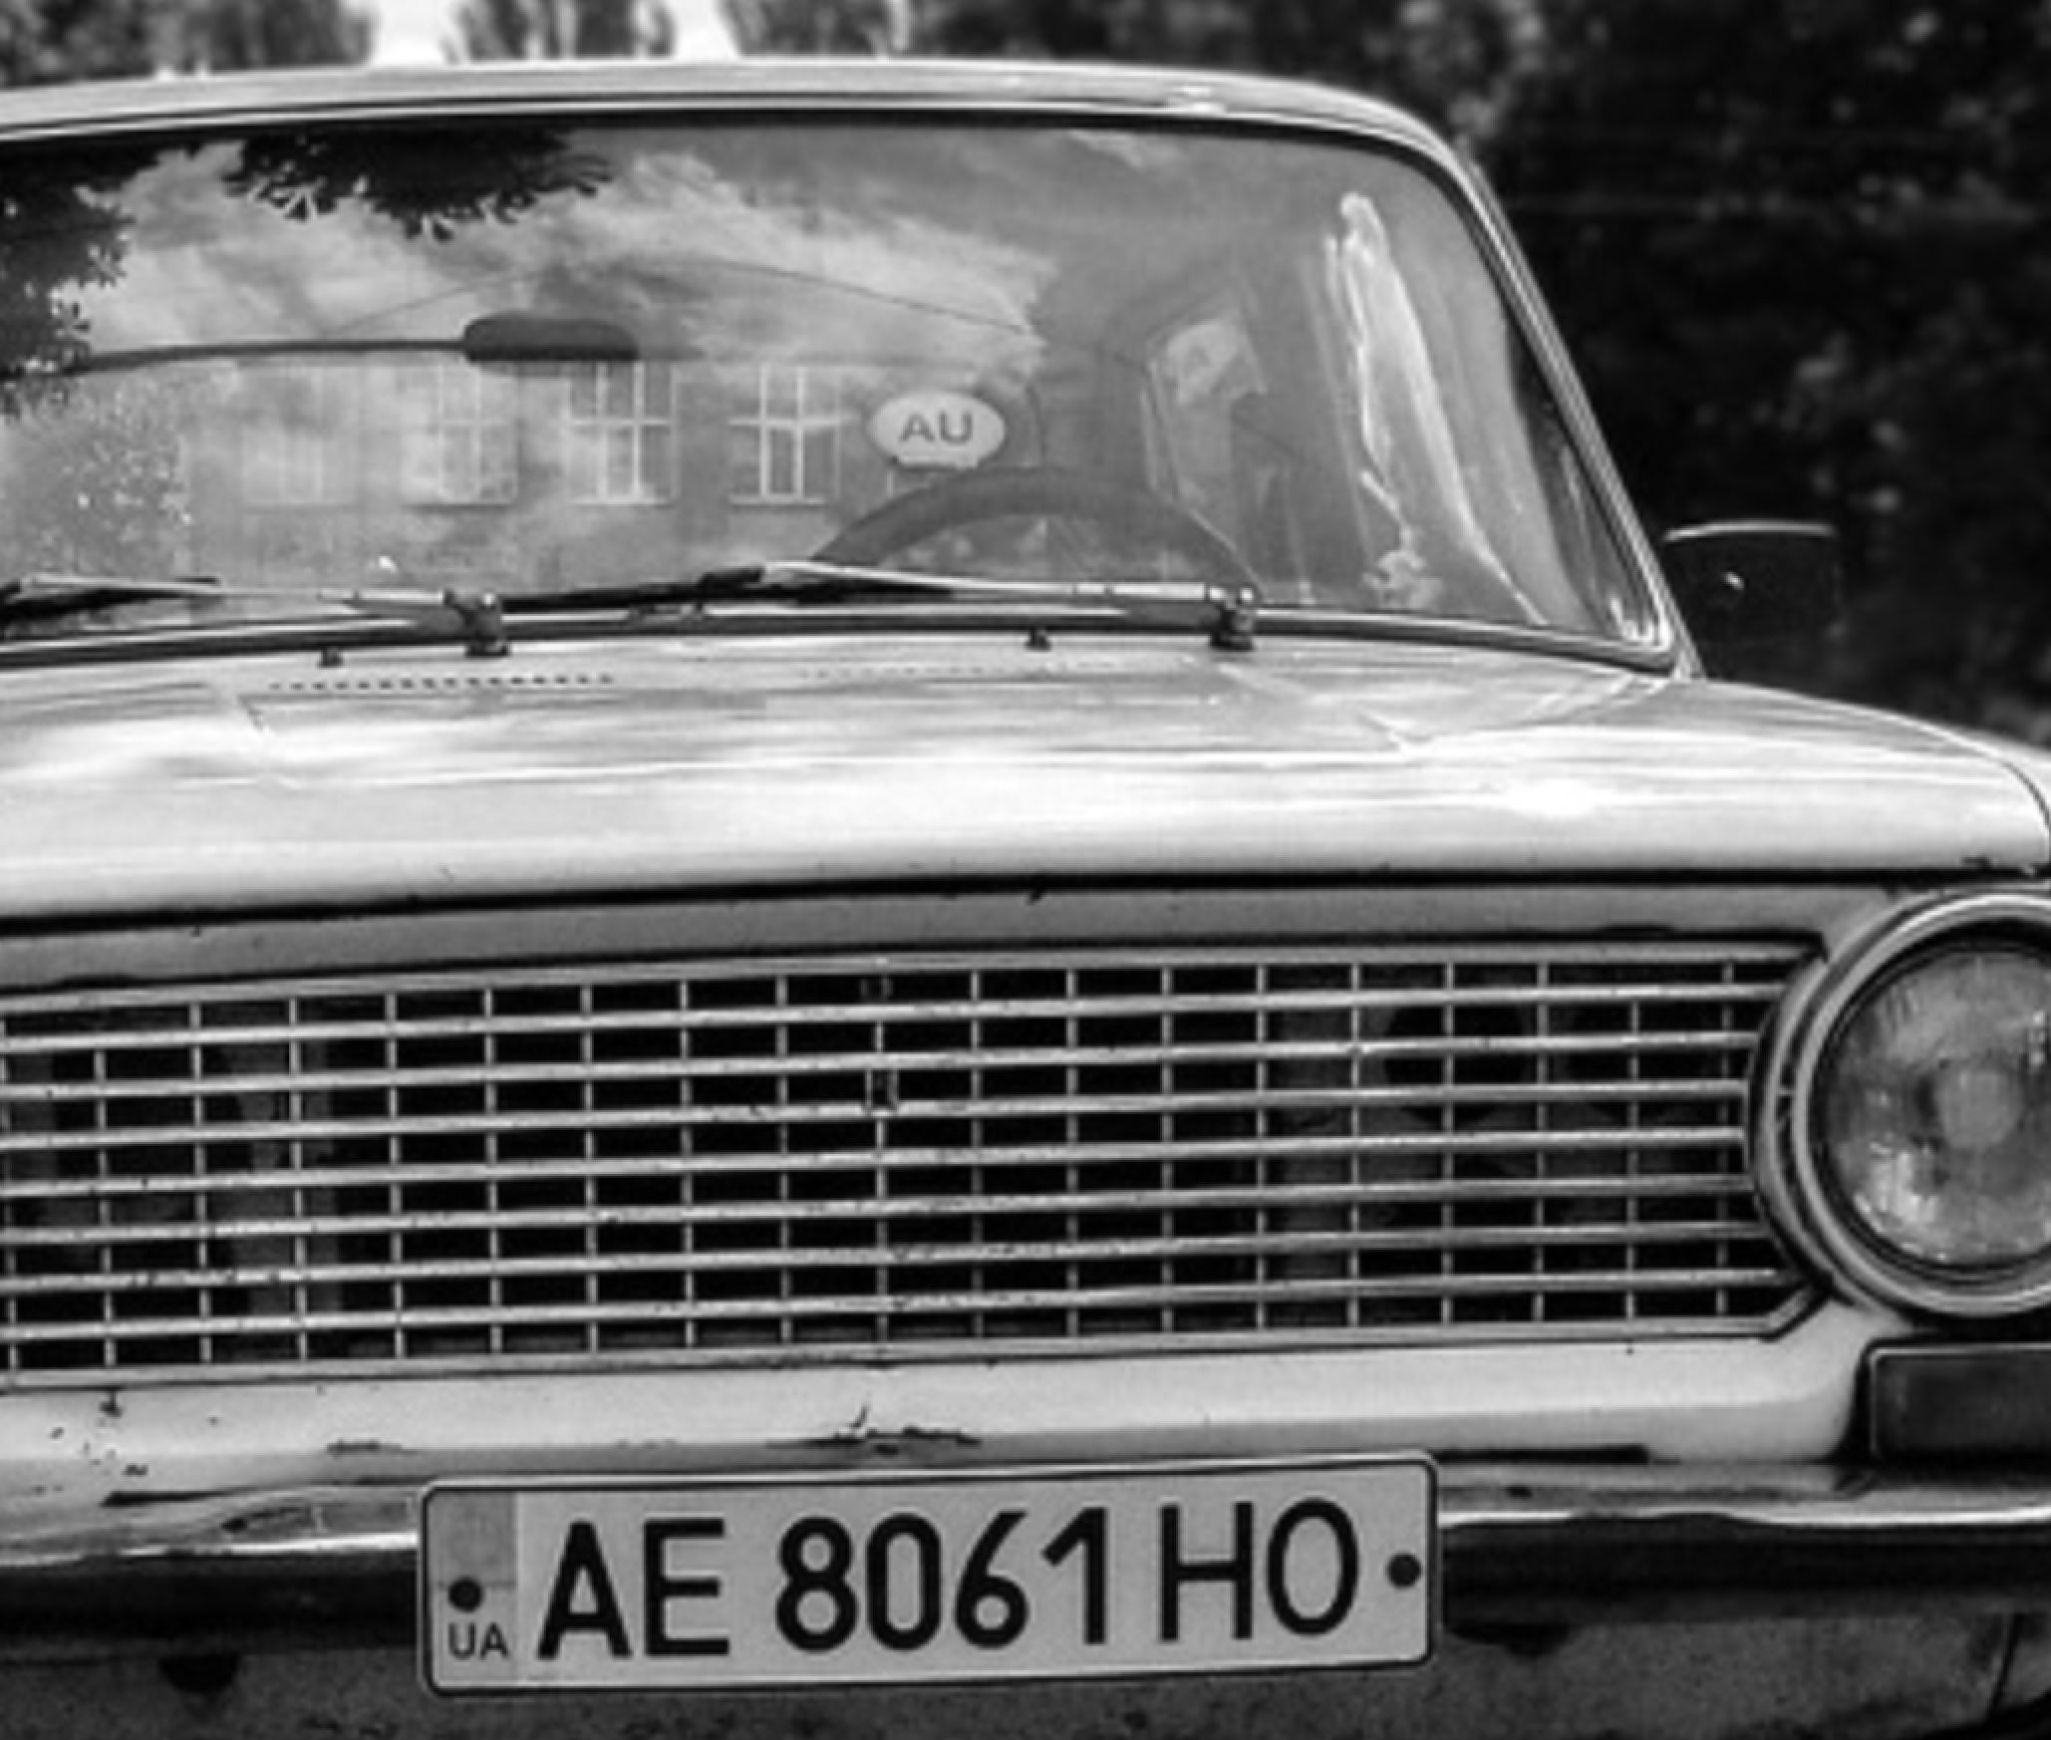
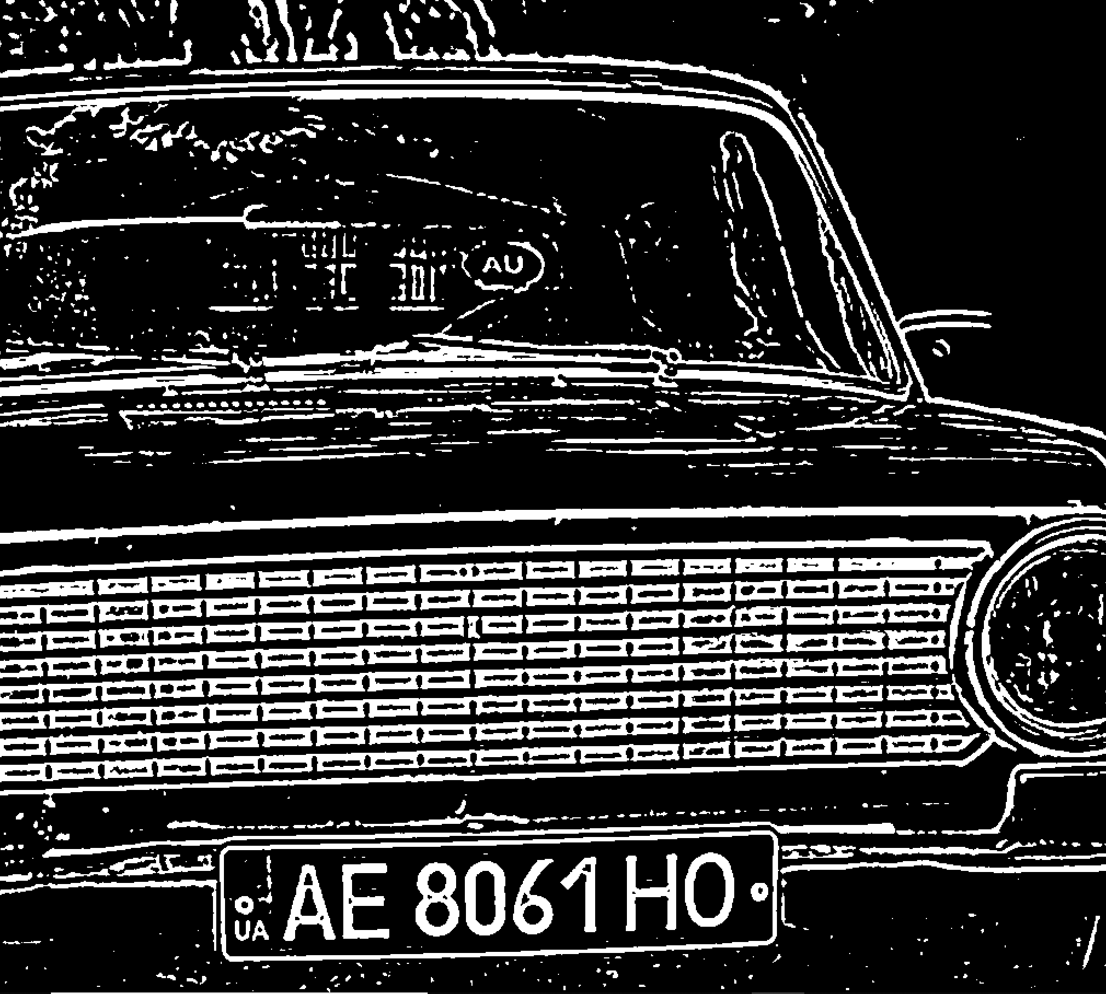
Result

Slide 8
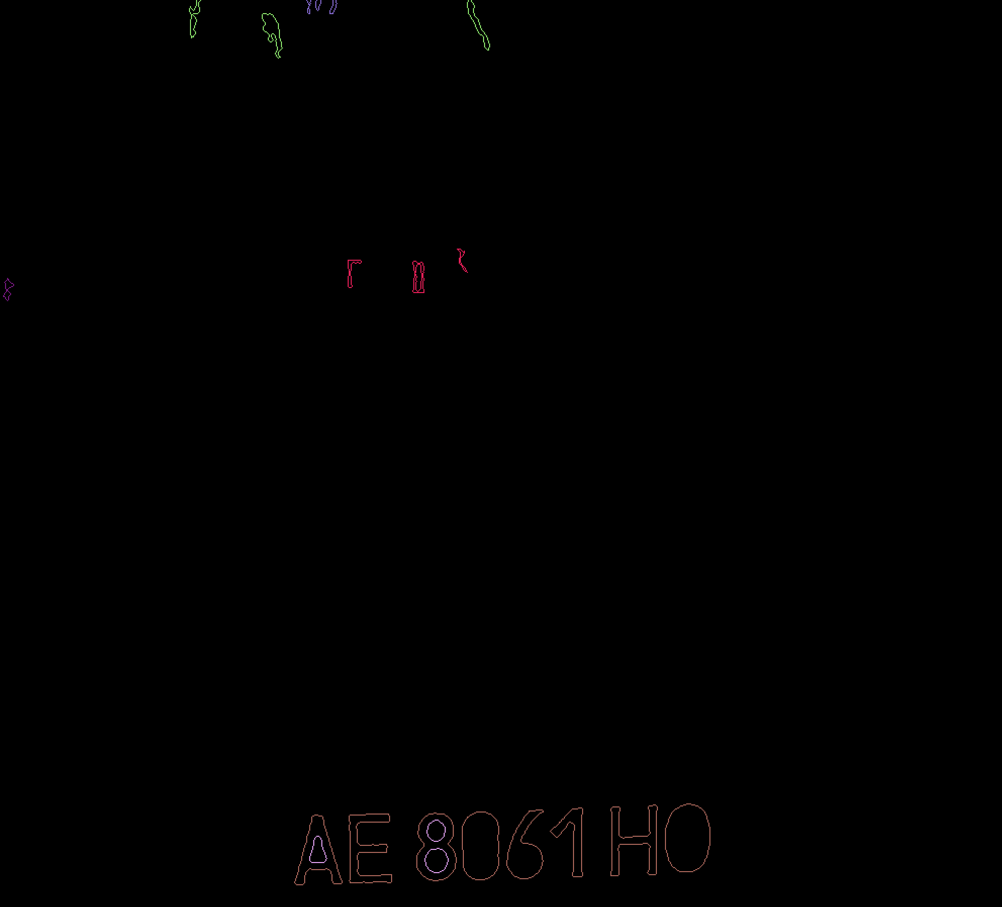
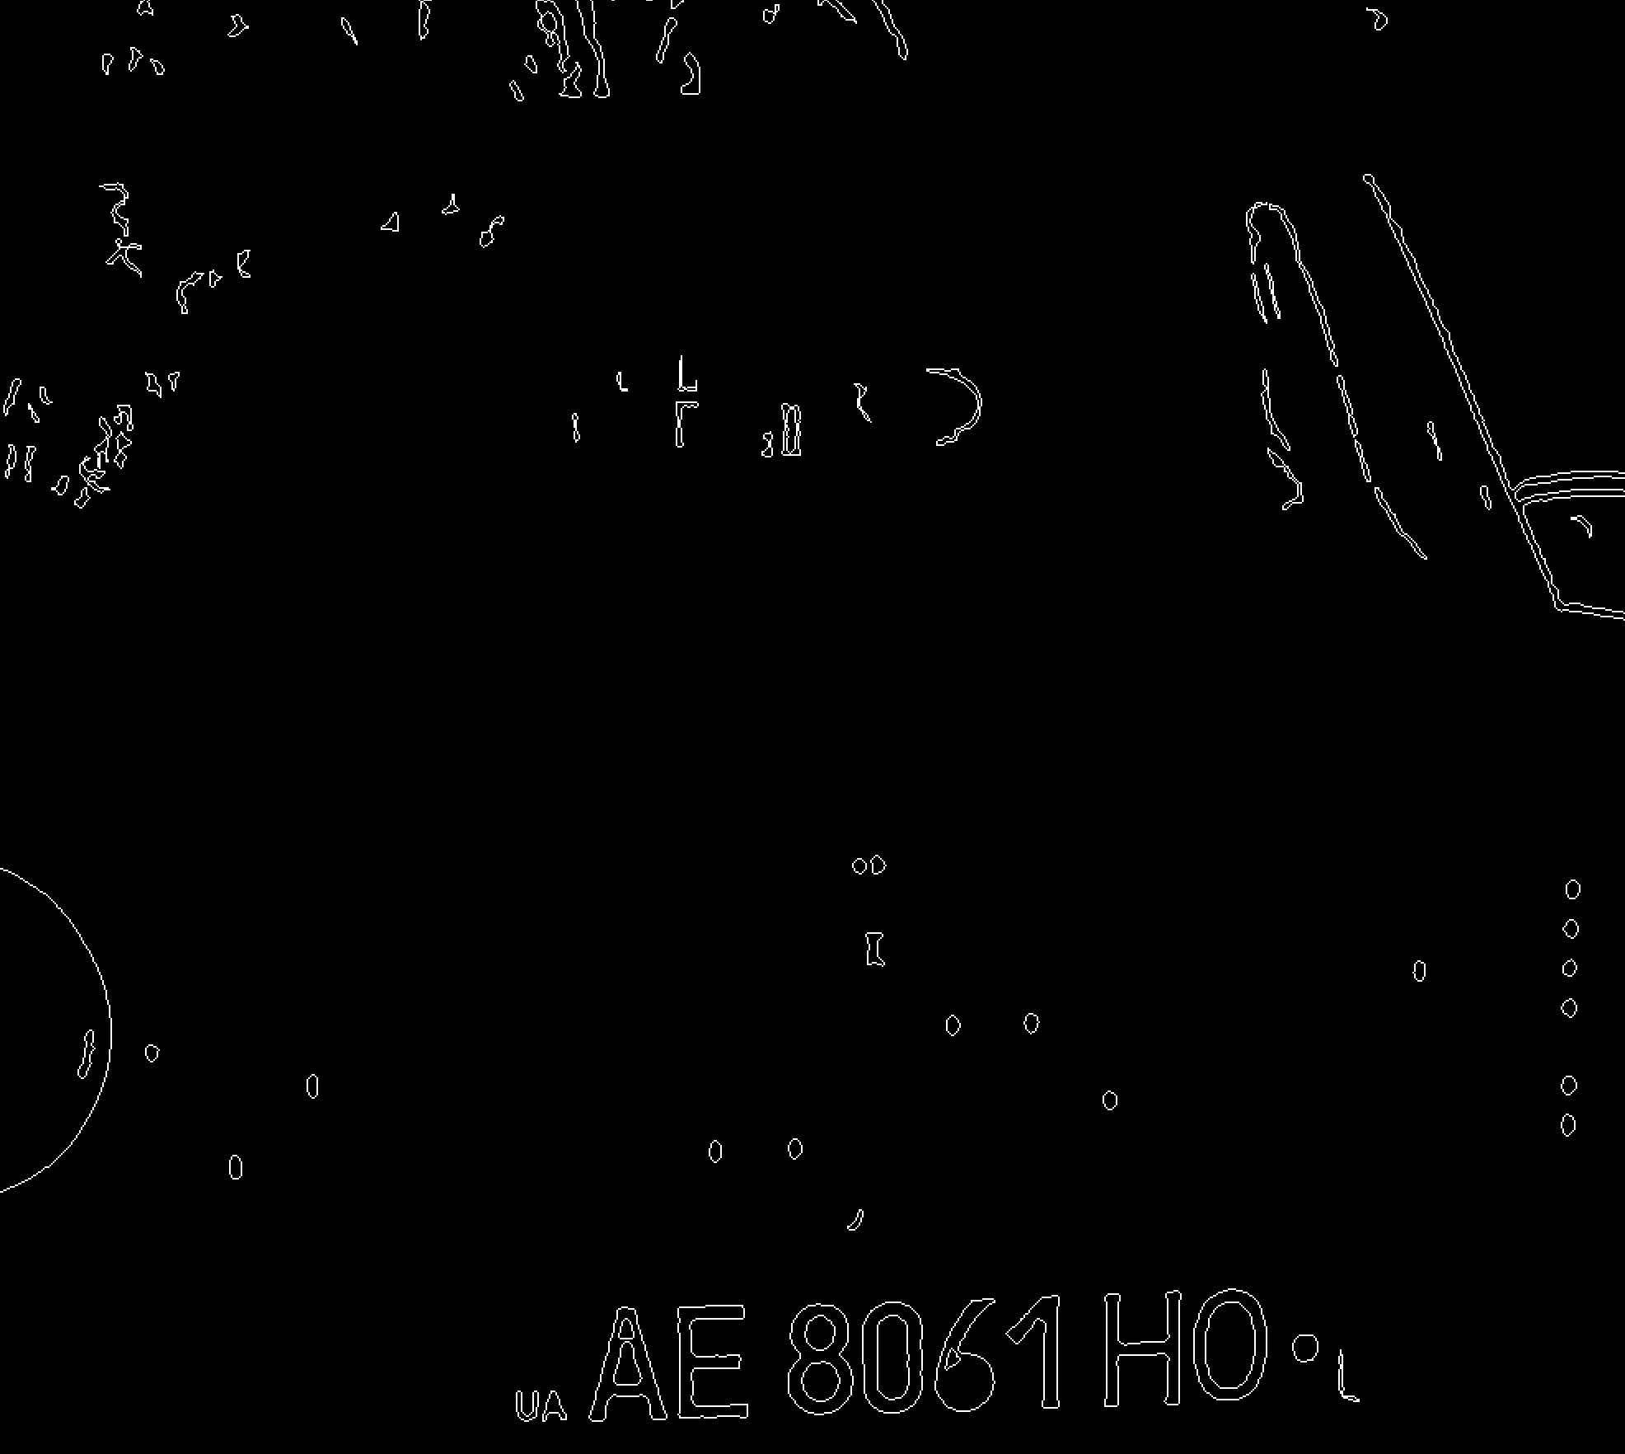

Result

Slide 9
Character Recognition
Preprocess
Character contour detection
Character Matching

Slide 10
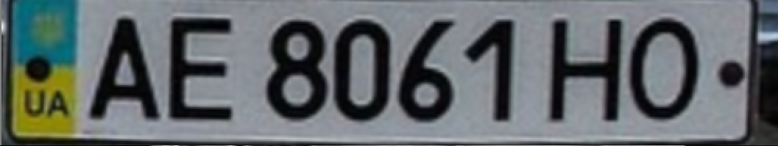

Result

Slide 11
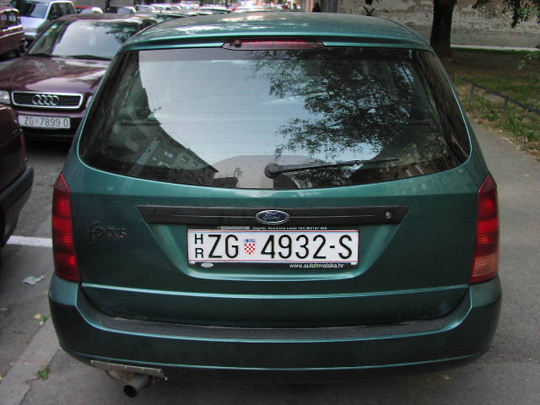
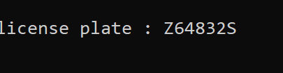
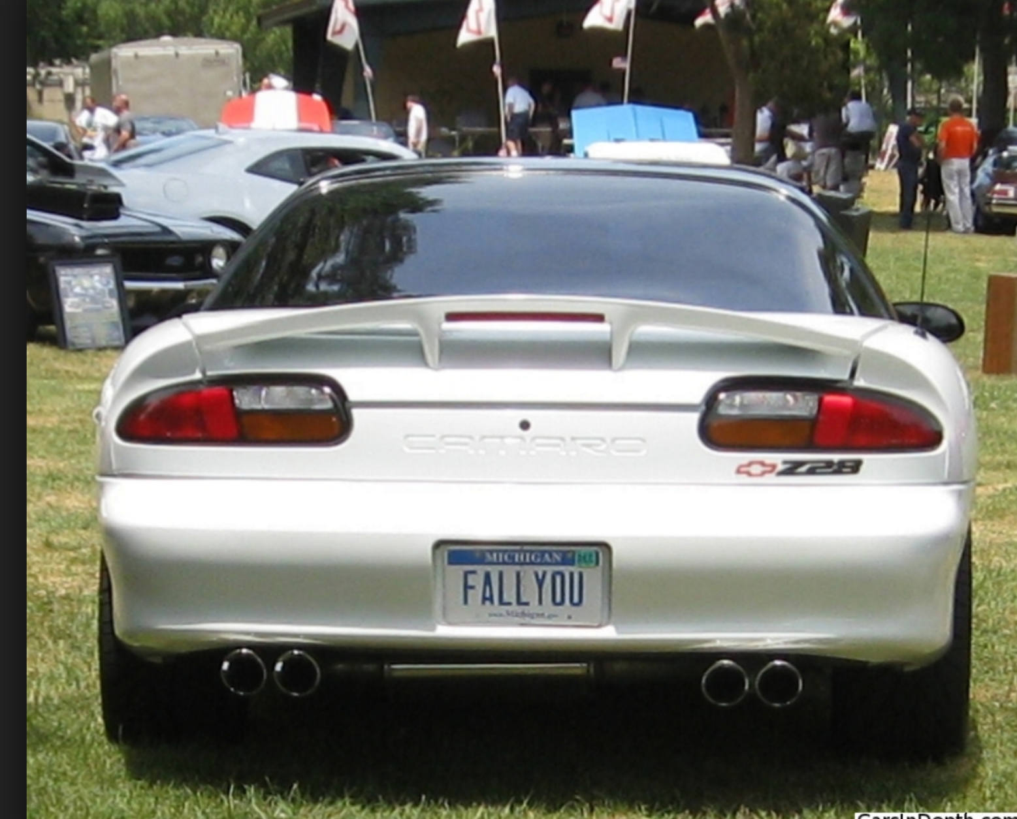
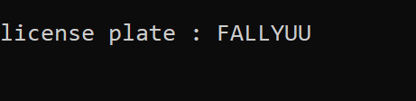
Experience

Slide 12
Conclusion
For the whole program, not many sophisticated algorithms are involved. But the process shows us how to apply simple concepts in a practical issue. Apparently, this is no easy, a lot of details are involved in the approaching. Some steps seem to be insignificant but we are enable to get the correct result if we handled them incorrectly. So, when we are facing a practical problem in the real world, things can be becoming complicated even if the fundamental concept is very simple.

Slide 13
Citation
Plate Detection and Recognition of Iraqi License Plate Using KNN Algorithm ,Abdul Hadi Mohammed Alaidi https://www.researchgate.net/publication/315380660_Plate_Detection_and_Recognition_of_Iraqi_License_Plate_Using_KNN_Algorithm
A Hybrid KNN-SVM Model for Iranian License Plate Recognition Sahar S.Tabrizi
https://www.sciencedirect.com/science/article/pii/S1877050916326278

